Slide 1
Department of Computer Science & Engineering
Heart Failure Detection Using
Machine Learning
Team Details (REGNO ,NAME):
21C021,DHAKSHESH T L A
21C049, MADHAV S
21C058,NAVEEN BABU N R
21C059,NIKIL N
18ES390 Design Thinking

Slide 2

Introduction
“Artificial Intelligence and Machine Learning models will enable us to build superior decision support systems to help our clinicians. They will also be much more intelligent in extending the continuum of care post procedure,”
Dr. Prathap Reddy, Chairman, Apollo Hospitals
PROBLEM STATEMENT:
Need for assistive devices for doctors in decision making related to predicting the risk of heart failure and prognosis of a cardiac patient.
18ES390 Design Thinking

Slide 3
Objective
To train the Machine learning model to detect heart failure and including Diabetes as an iimportant parameter.
To include more lab oriented and behavioral data as supporting parameters.
To train in different other ML models expecting higher accuracy.
To give Doctors a tool to help them diagnose heart failure problems early.
To receive treatments effectively and avoid serious repercussions.
18ES390 Design Thinking

Slide 4
Scope of the project
Predicts the recovery rate of a cardiac patient from heart failure.
Predicts the risk of encountering a heart failure
Helps the doctor in deciding whether the patient’s life is at risk from the analysis of this model and act accordingly
18ES390 Design Thinking

Slide 5
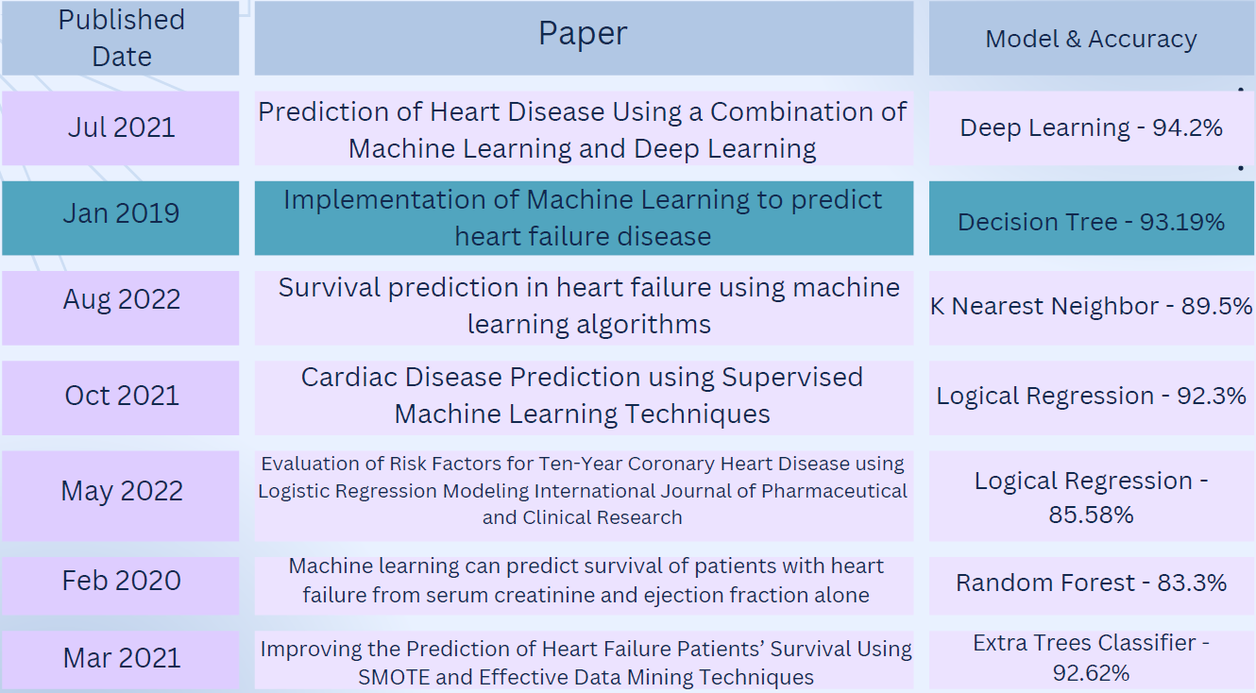
Literature Survey
18ES390 Design Thinking

Slide 6
Societal Impact:
If implemented with the desired accuracy, this acts as a tool to help doctors diagnose heart failure problems early. This also acts as an additional support system to doctors to be sure about their diagnosis and treatment. This ensues patients receiving treatments effectively and avoid serious repercussions.
18ES390 Design Thinking

Slide 7
Stakeholders Requirements
Target - Hospitals
End Users - Doctors & Patients
Clients - Patients
Developers - Programmers
Deliverable Product : Mobile Application
18ES390 Design Thinking

Slide 8
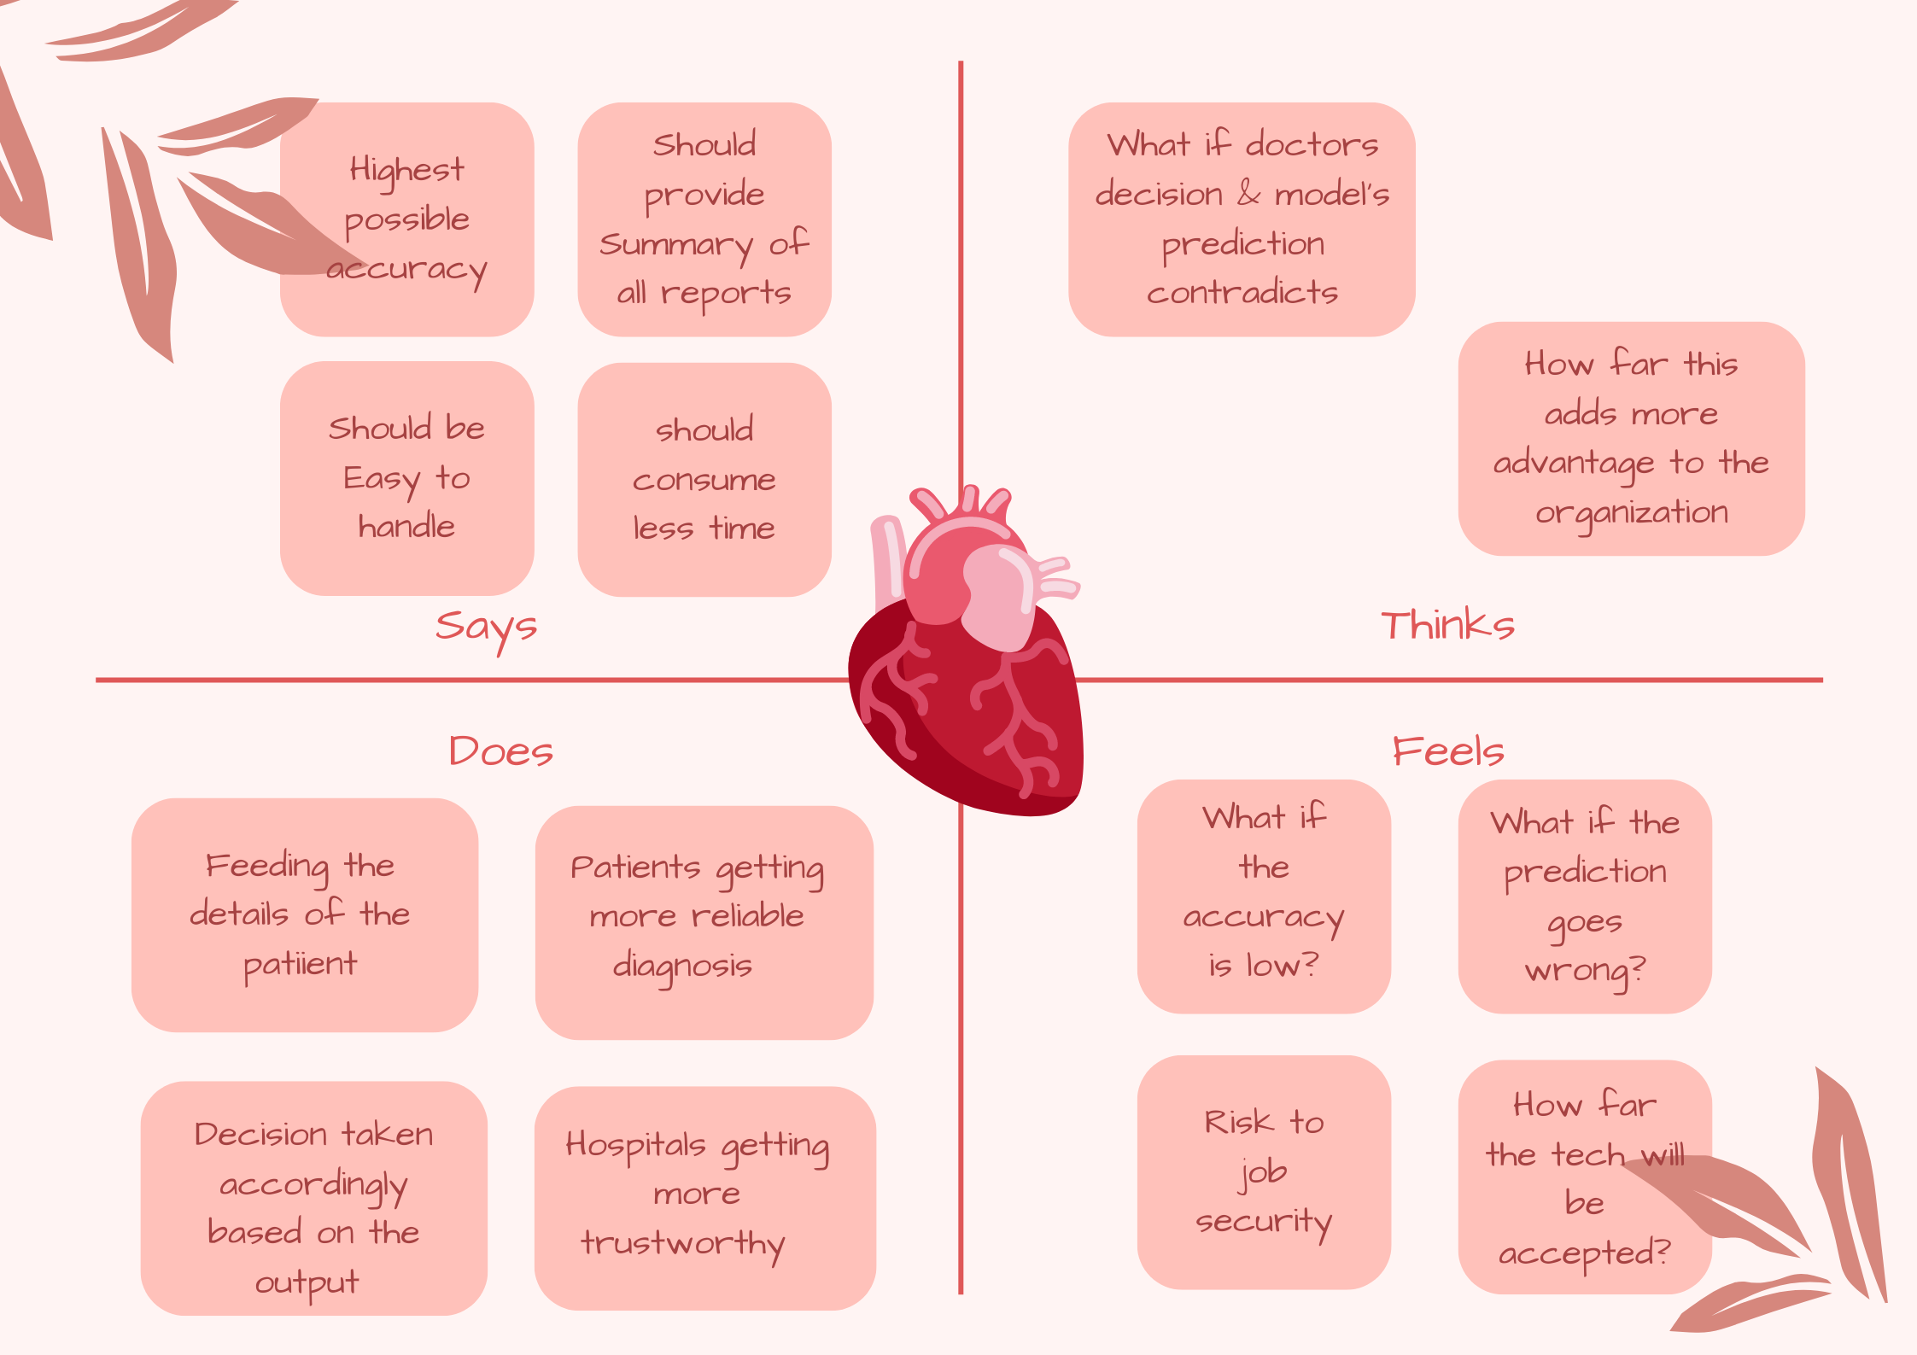
Empathy Map
18ES390 Design Thinking

Slide 9
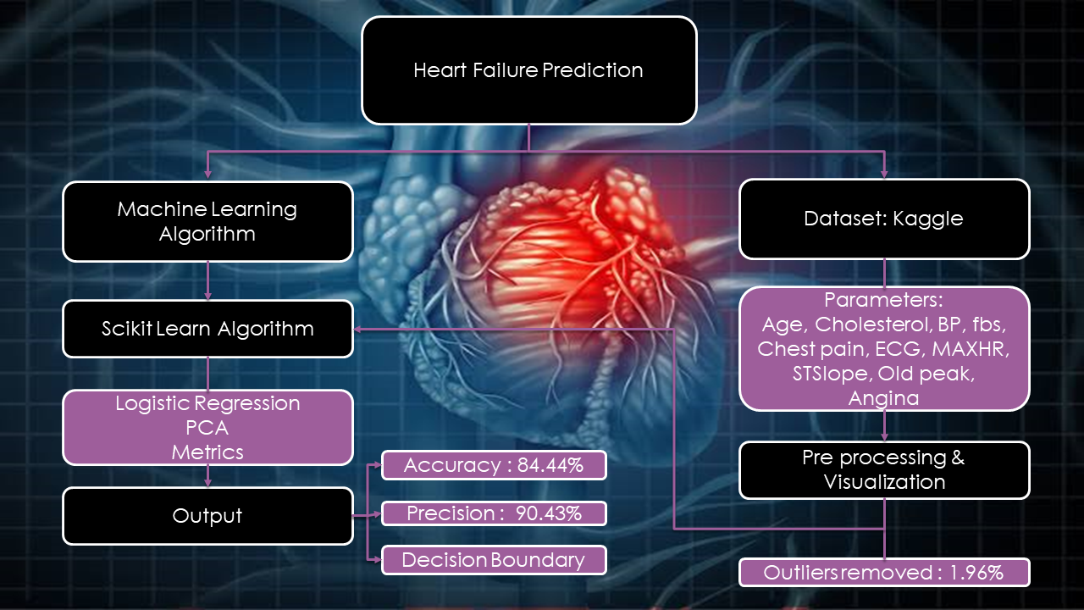
Workflow Diagram
18ES390 Design Thinking

Slide 10
Design Prototype
The final prototype of our project is a Logistic Regression machine learning model built using the Scikit learn tool in Python Jupyter note book to predict the risk of heart failure for a given patient details on the following parameters:
AGE | RESTING ECG
RESTING BP | MAX HR
CHOLESTROL | EXERCISE ANGINA
GENDER | OLD PEAK
FASTING BLOOD SUGAR | ST SLOPE
CHEST PAIN TYPE
18ES390 Design Thinking

Slide 11
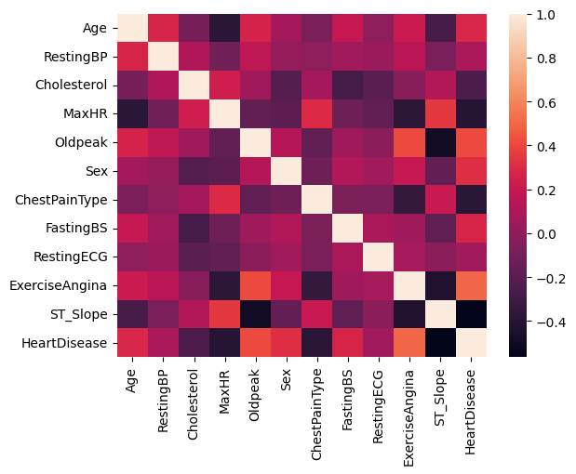
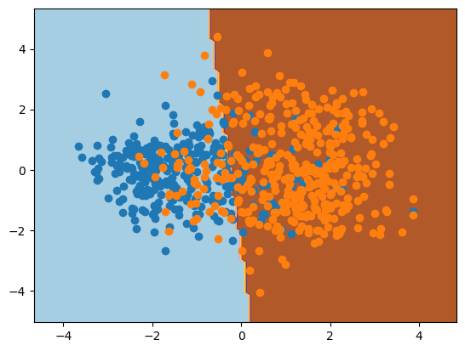
Results (if u have completed /Partial completion Screenshots)
18ES390 Design Thinking

Slide 12
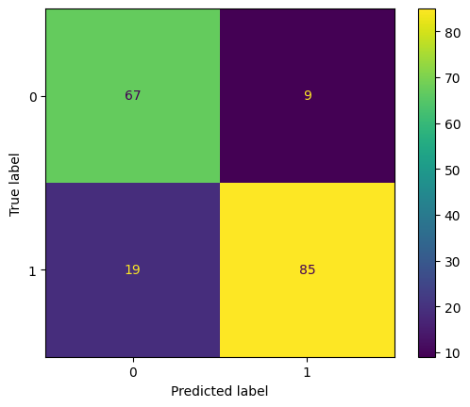
OUTPUT OF THE MODEL:
The model developed was tested with data set and also with synthetic user input and obtained the following results:
Outliers removed: 1.96%
Accuracy : 84.44%
Precision : 90.43%
F_Score : 85.86%
18ES390 Design Thinking

Slide 13
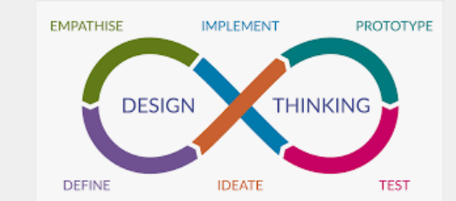
Thank You!
Image Courtesy: https://www.google.com/search?q=Design Thinking
Team Details
18ES390 Design Thinking

